Slide 1
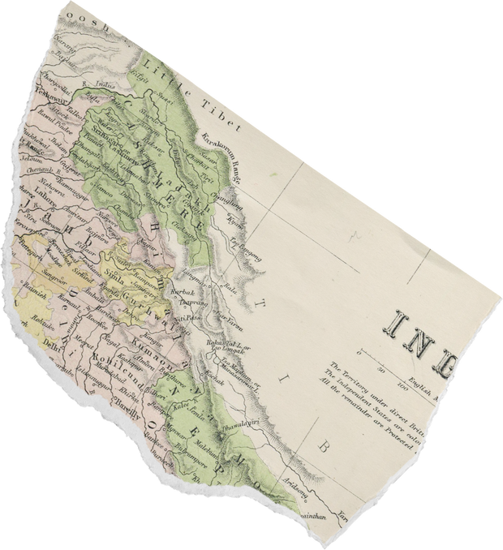
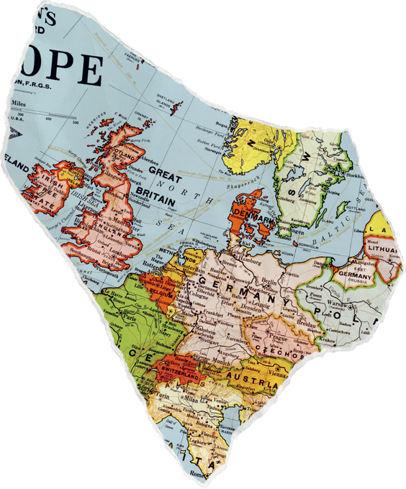
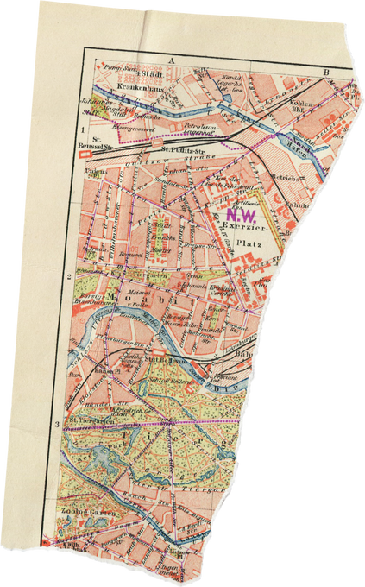
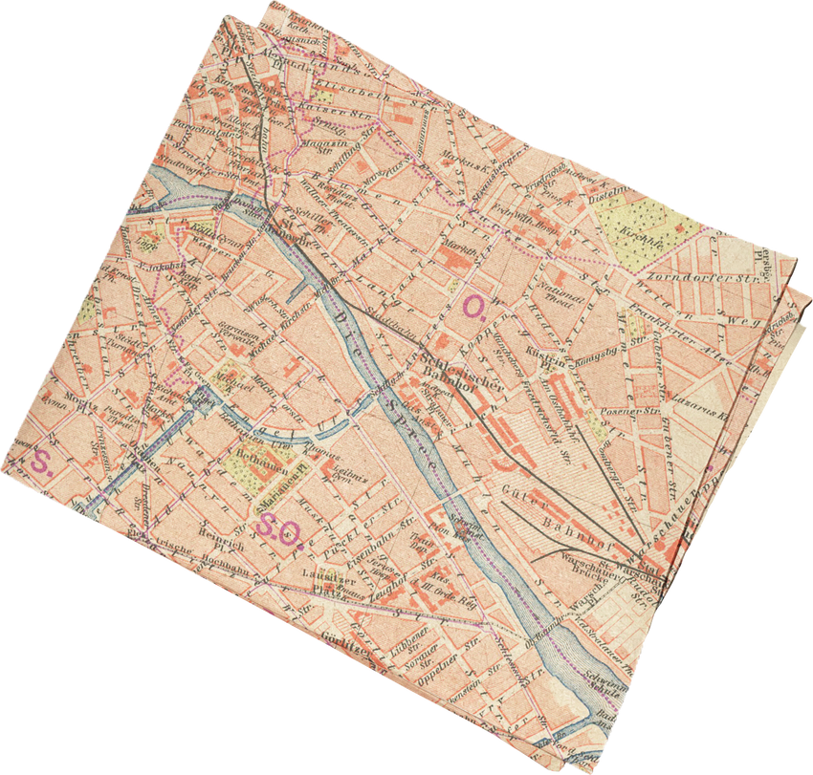
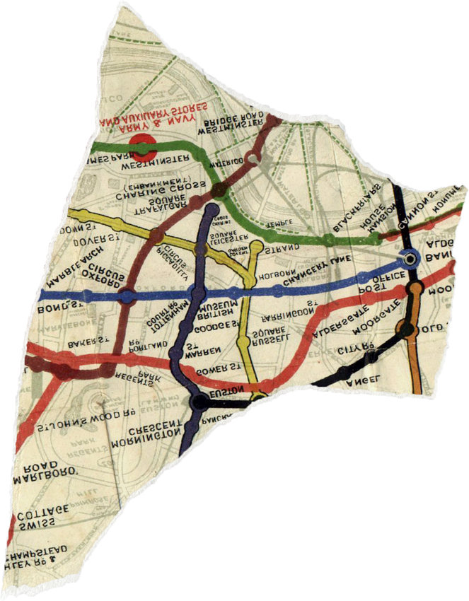
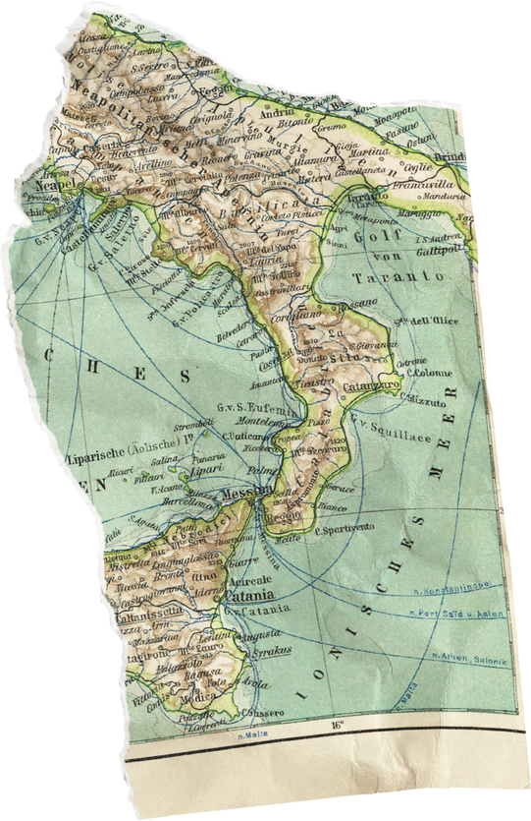

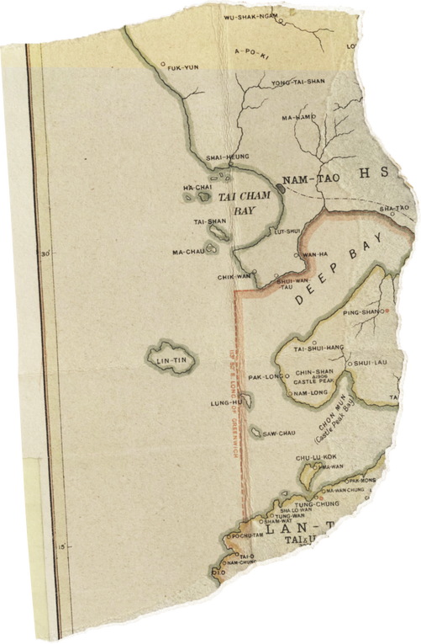
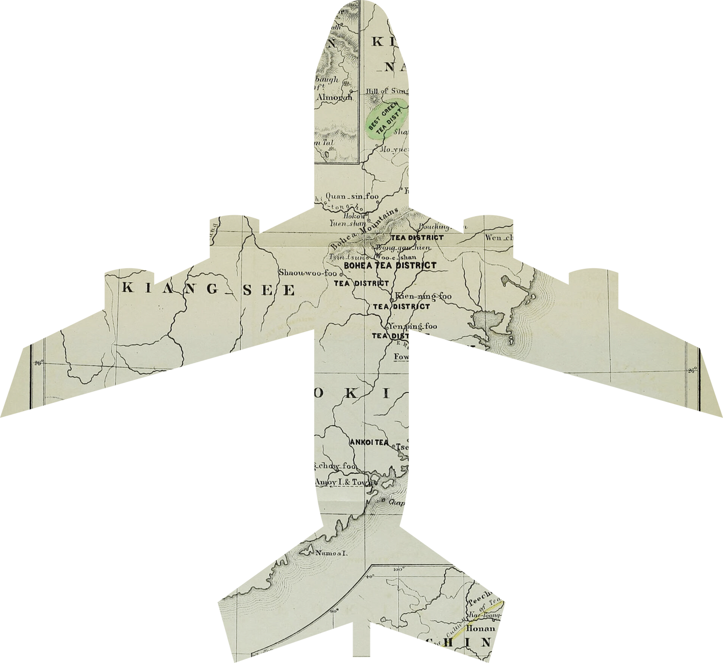

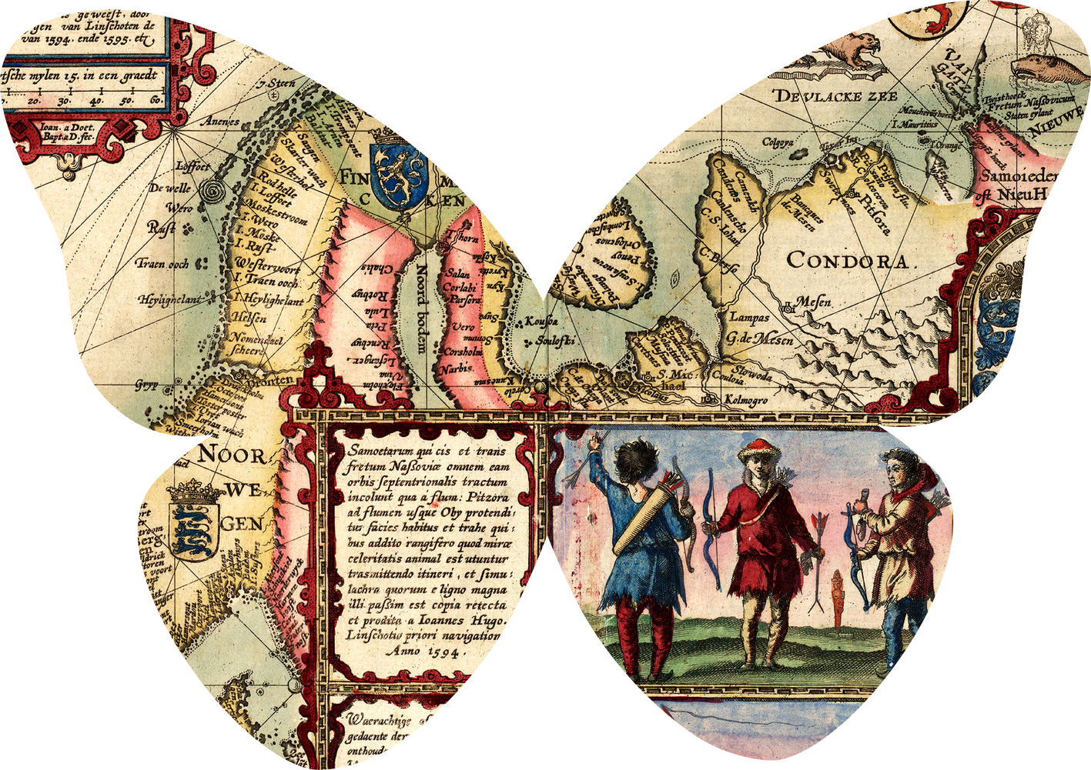
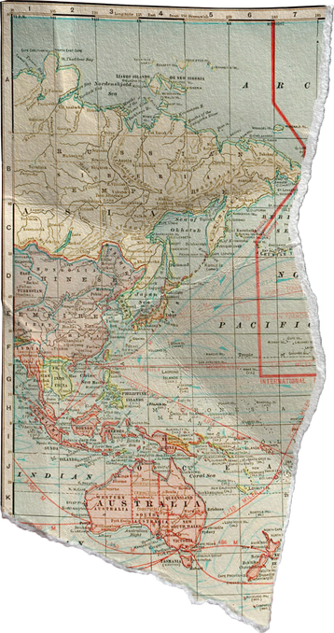
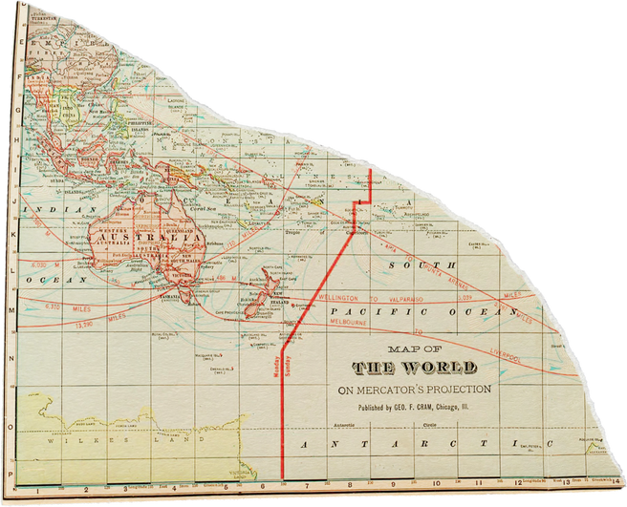
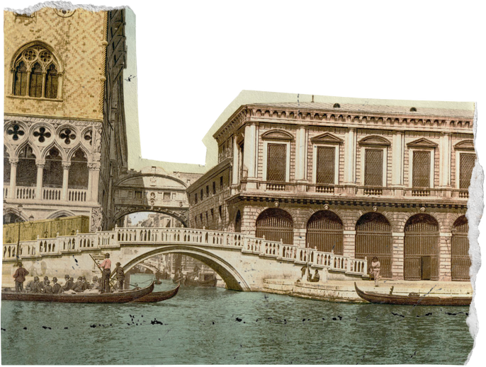
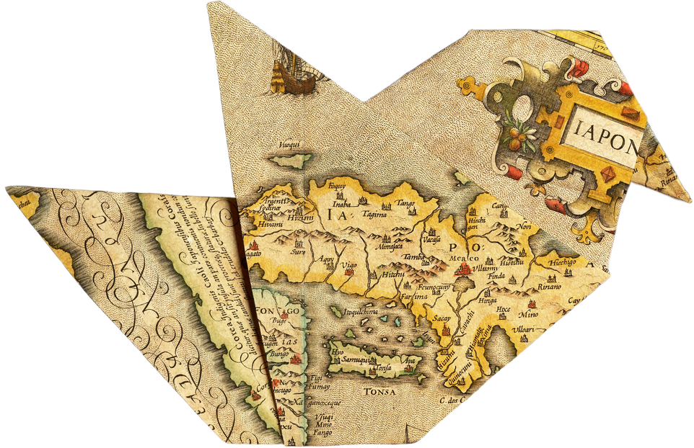
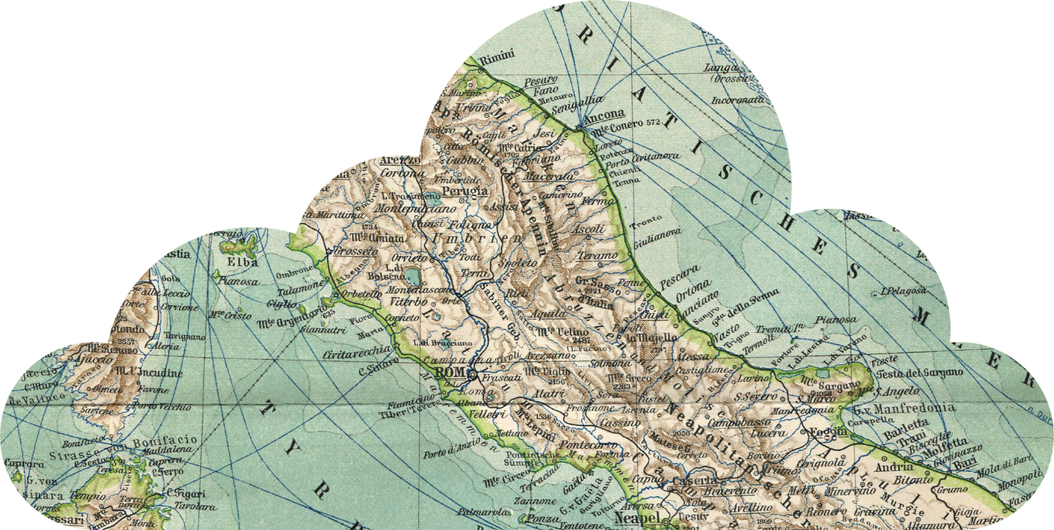
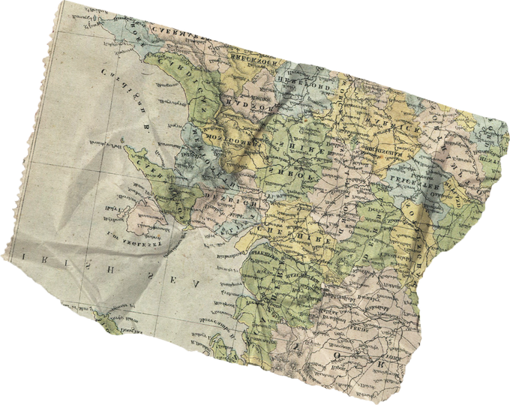
Happy Vacations
A Travel Planner Application
Presented by: Praneeta, Sandeep and Shivani

Slide 2
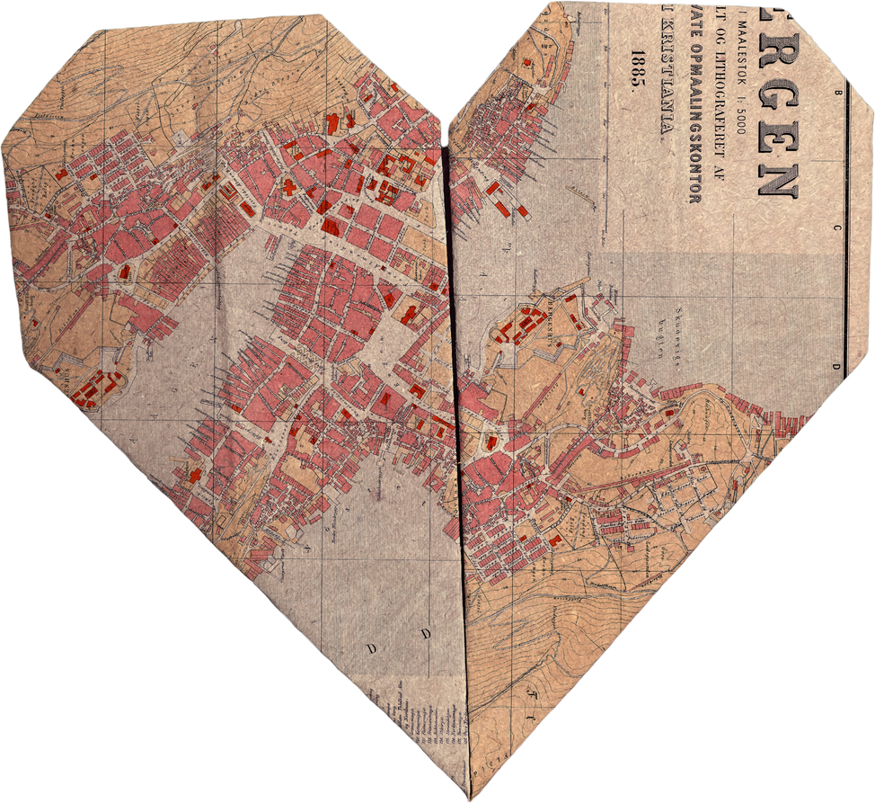
Introduction
"Happy Vacations" is a comprehensive web application designed to assist travelers in organizing and managing their trips.
It typically includes various features and functionalities to help users plan, book, and navigate their journeys more efficiently.

Slide 3
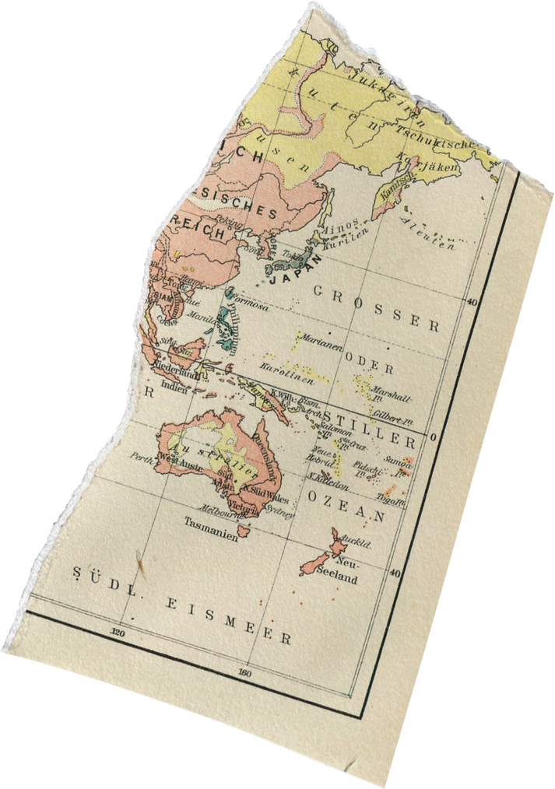
Modules & Microservices:
Login module:
Admin module:
User Module:

Slide 4
Database & Tables:
Database name: travel
Table1 name: Trip_details
Consists of
- Id
- location
- description
- duration
- accomodationFee
- foodFee
- travelFee
- guideFee
Table2 name: user
Consists of
- Id
- firstName
- lastName
- email
- password
Table3 name: role
Consists of
- Id
- name

Slide 5
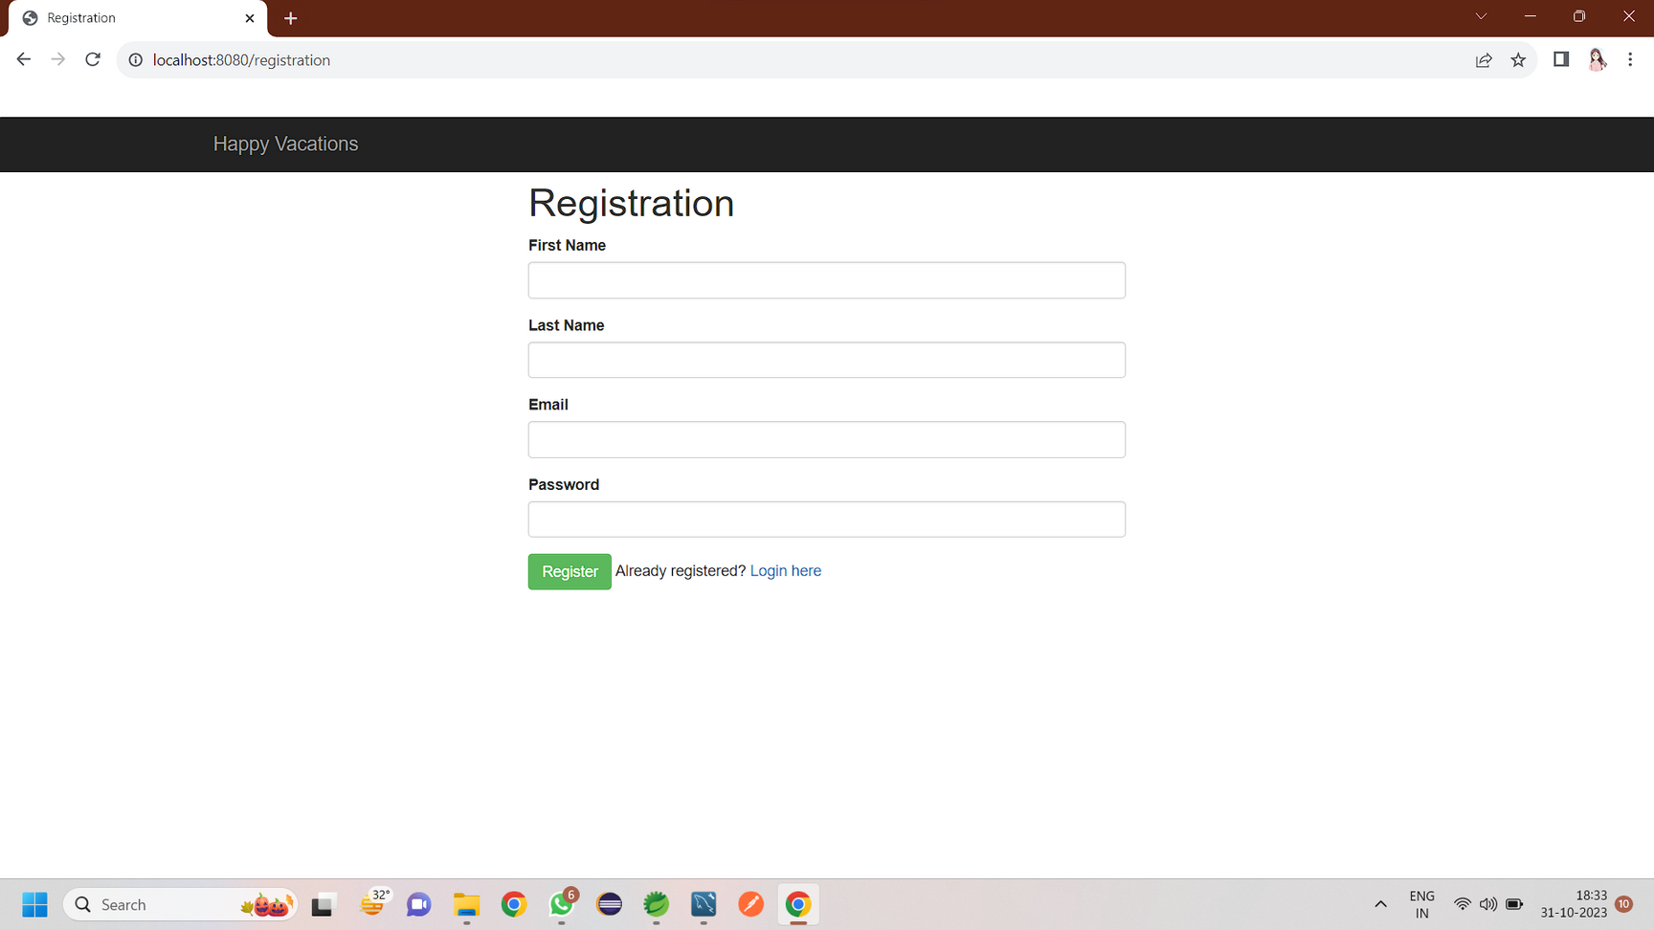
Registration page:

Slide 6
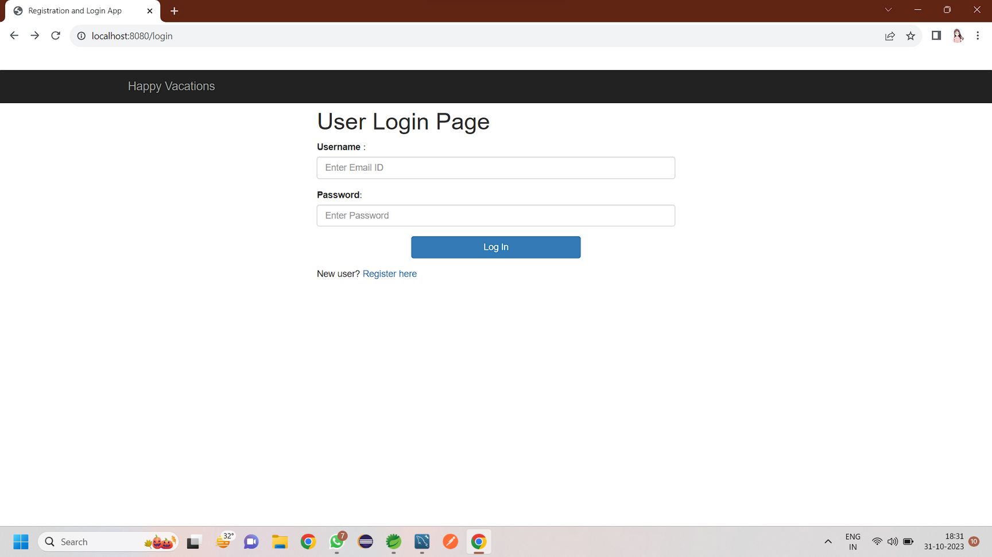
Login page:

Slide 7
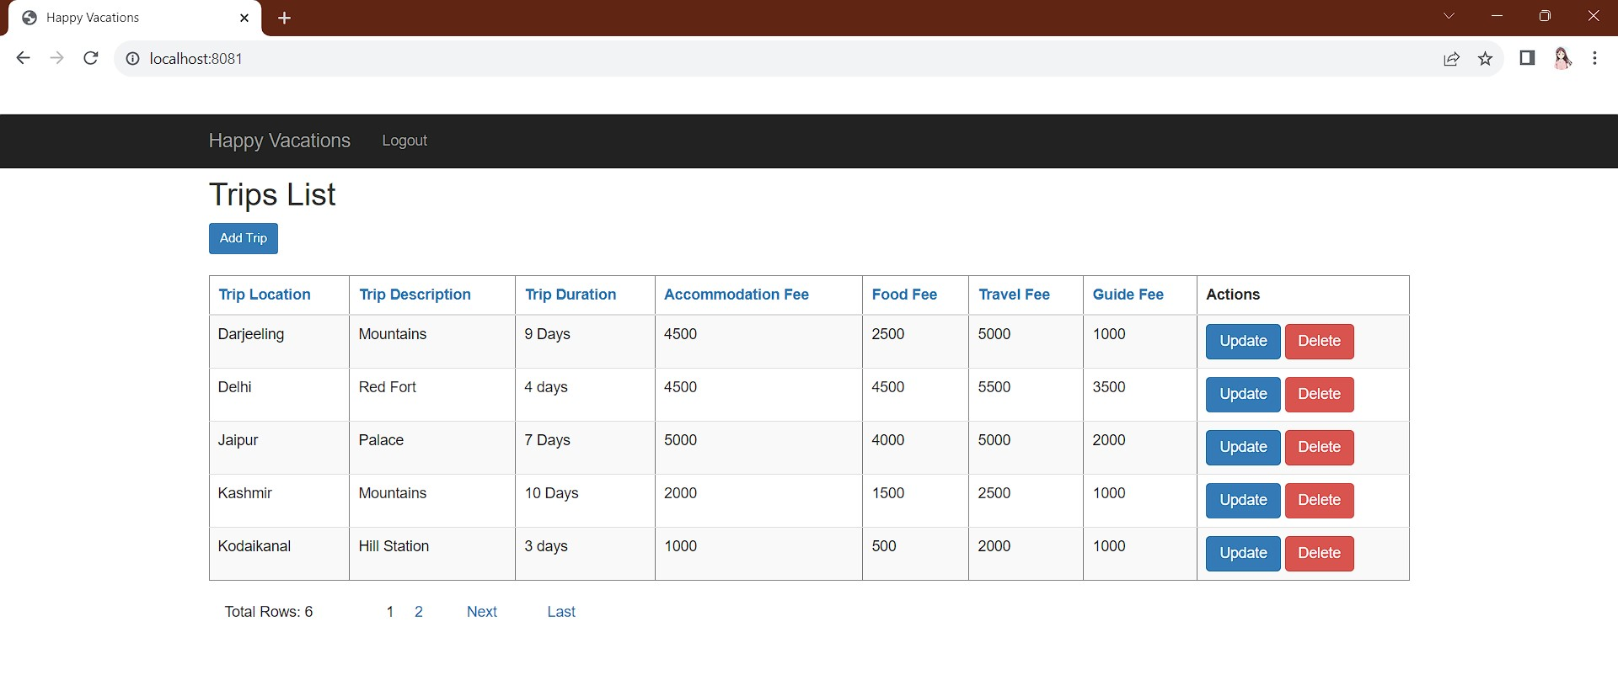
Admin page:

Slide 8
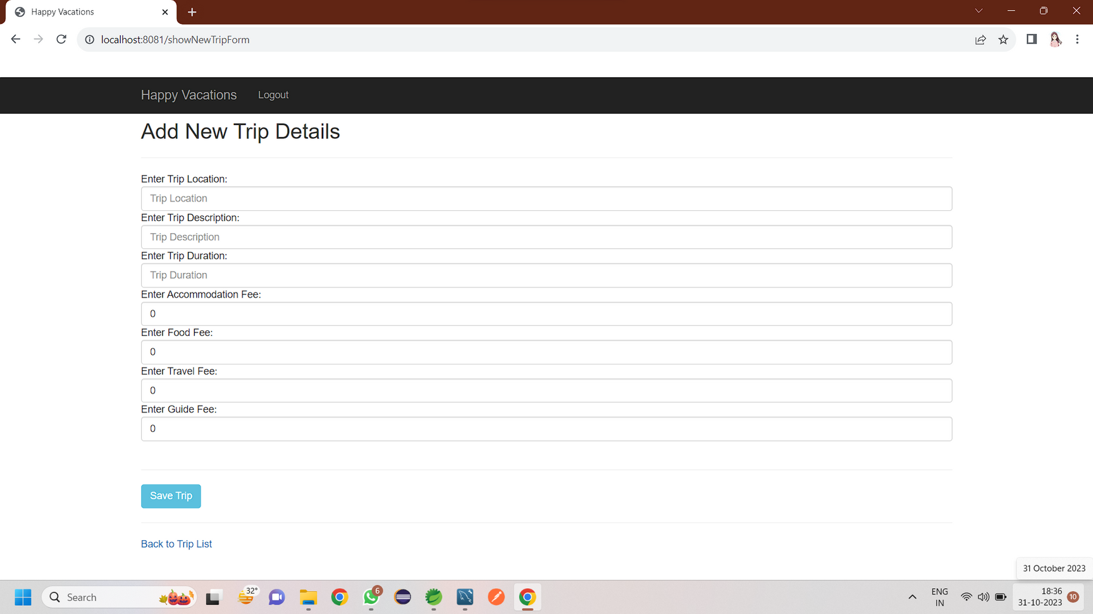
Add new trip page:

Slide 9
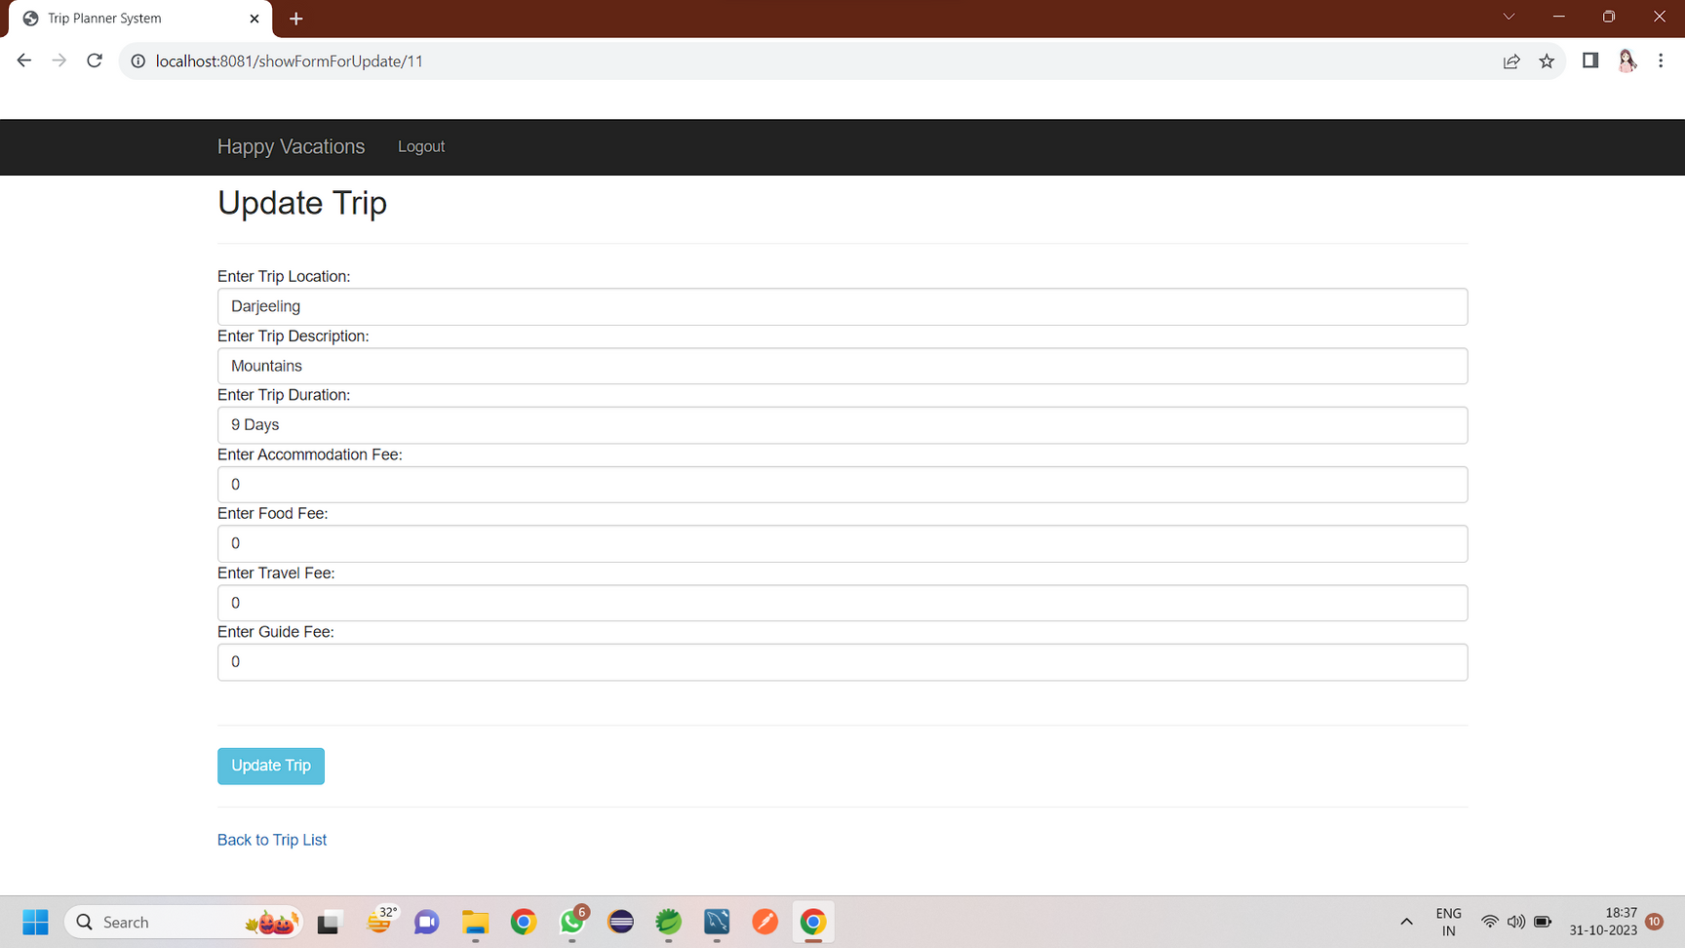
Update existing trip page:

Slide 10
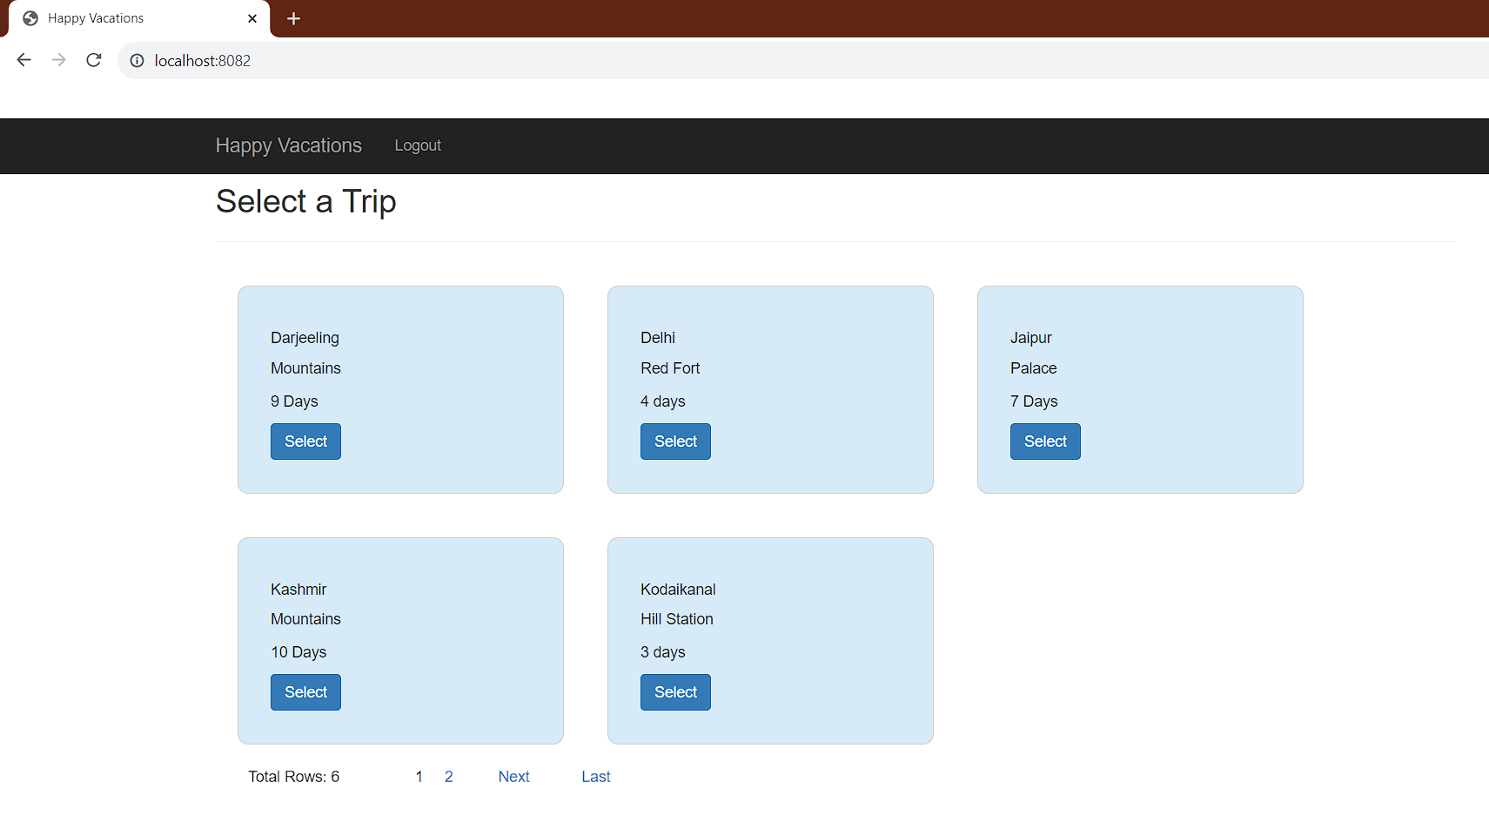
User dashboard page:

Slide 11
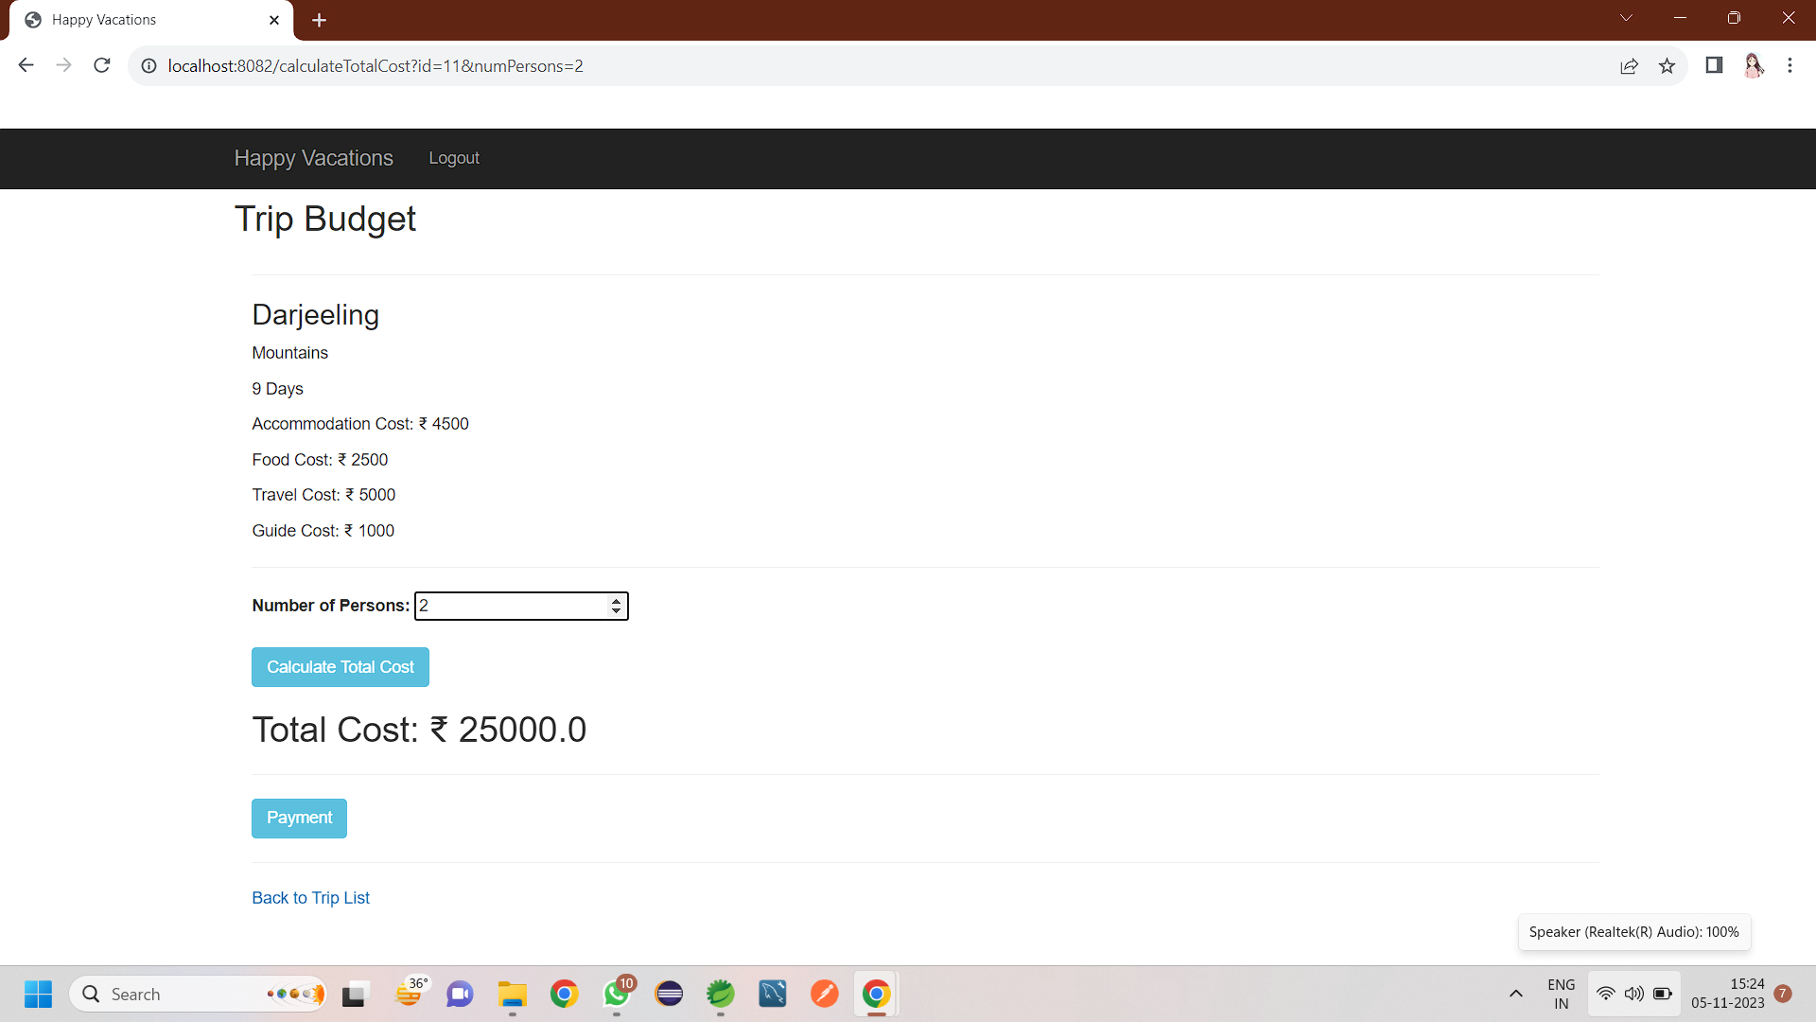
User selection page:

Slide 12
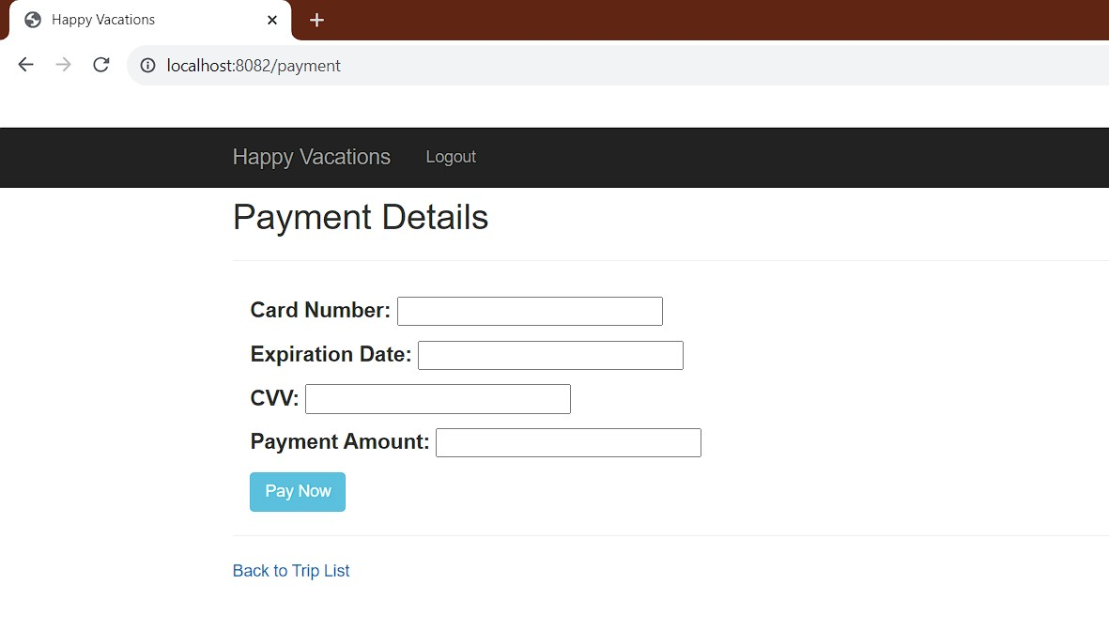
User payment page:

Slide 13
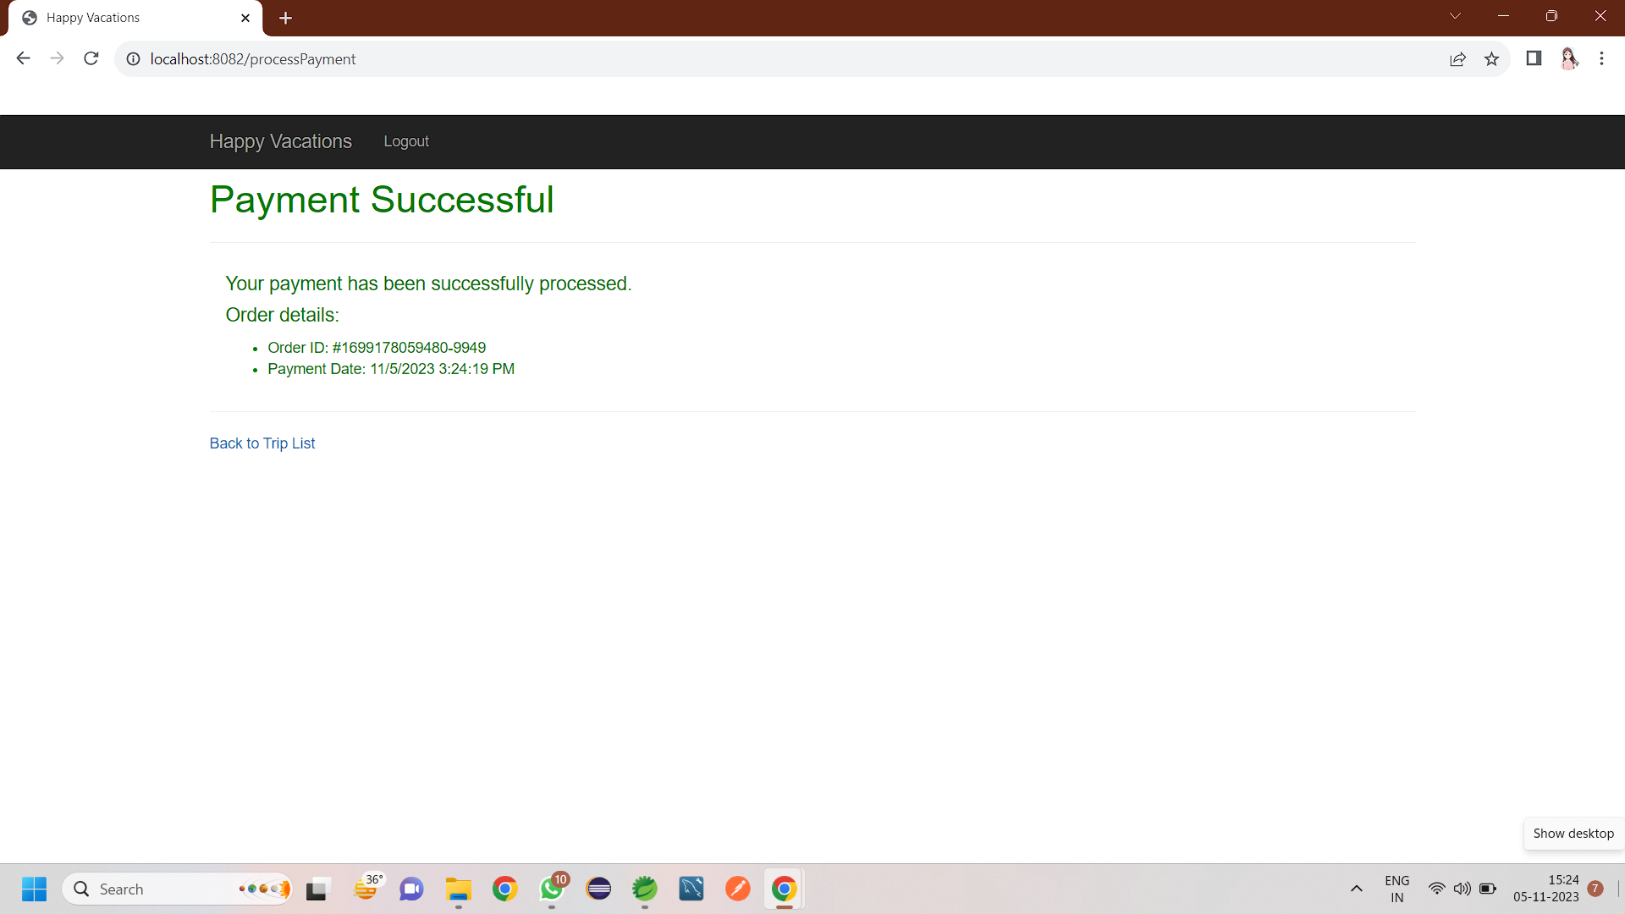
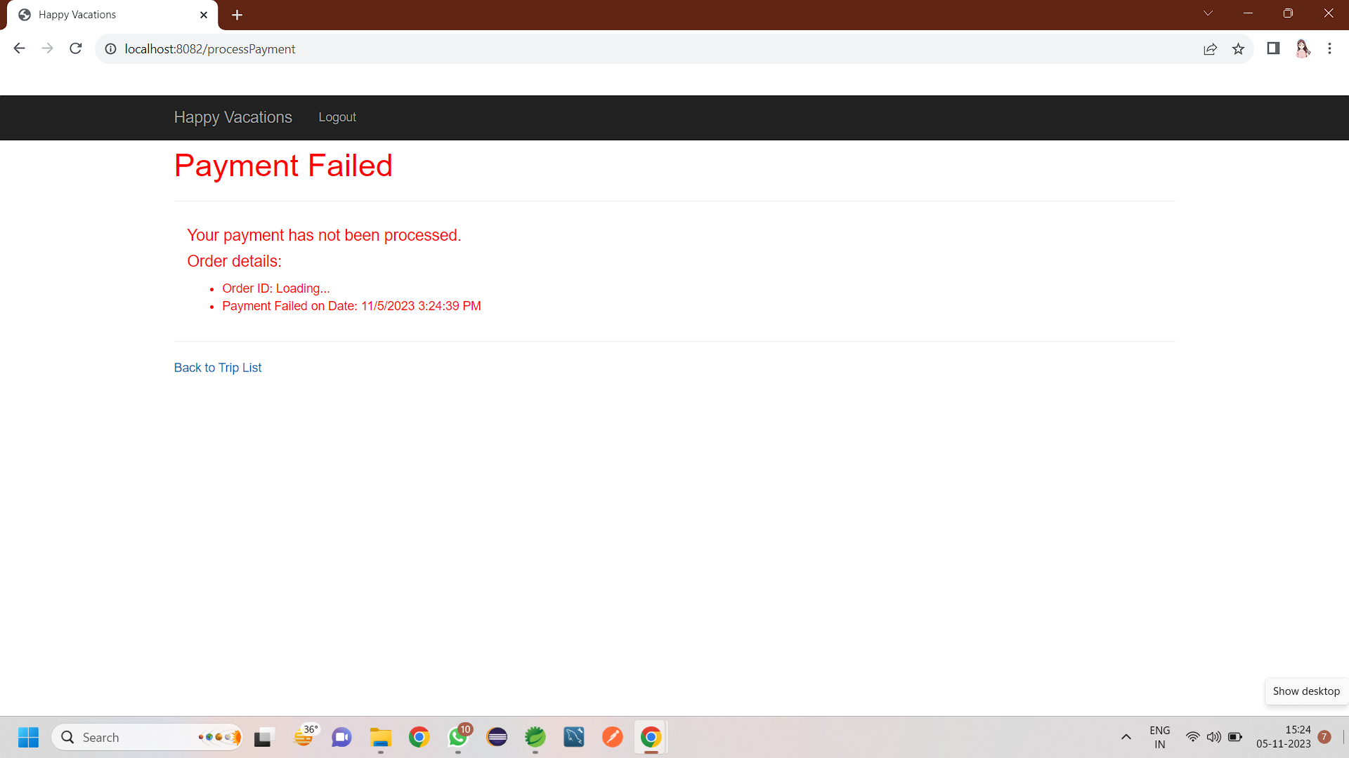
Payment Success and failure page:

Slide 14
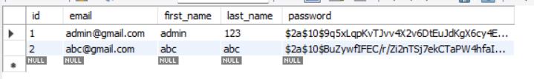
Database table entries:

Slide 15
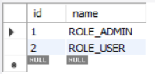
Database table entries:

Slide 16
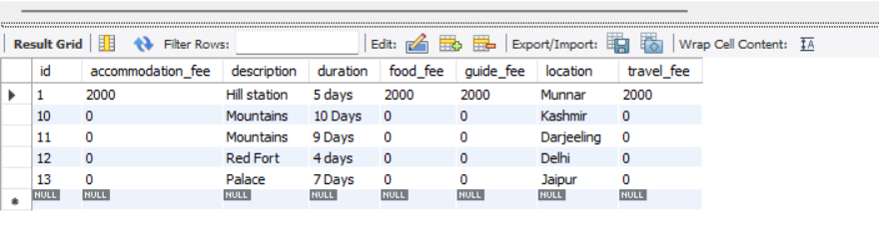
Database table entries:

Slide 17
Thank you very much!

